Slide 1


SkillLens: Student Placement Intelligence System Using Data Warehousing and Data Mining
CSA1606 – Data Warehousing and Data Mining
Presented by:
HARESH KUMAR N L – 192425009
AJAY I – 192421147
SAKTHI KAILASH T – 192411068
Guided by:
Dr Renuga S

Slide 2
INTRODUCTION
Overview of the Project
Educational institutions generate large volumes of academic, skill, internship, and placement data every year.
These data sources are often stored separately, making analysis and decision-making difficult.
This project develops a centralized Data Warehouse to integrate student information from multiple sources.
Data Mining techniques are applied to discover hidden patterns, predict placement outcomes, and analyze factors influencing employability.
Interactive dashboards built in Power BI provide meaningful insights to students, faculty, and placement officers.
Purpose of the Project
Develop a centralized Student Placement Data Warehouse.
Analyze academic and skill-based performance using Data Mining techniques.
Predict placement opportunities using Machine Learning.
Support placement cells in making data-driven decisions.
Visualize placement trends through interactive Power BI dashboards.

Slide 3
OBJECTIVE
Goals:
Build a centralized Data Warehouse using ETL processes.
Design a Star Schema for efficient analytical processing.
Predict student placement status using Decision Tree Classification.
Group students with similar placement potential using K-Means Clustering.
Discover relationships between student attributes using Apriori Association Rule Mining.
Develop interactive Power BI dashboards for placement analysis.
Problem Statement:
Educational institutions collect large volumes of placement-related data, but the information is often fragmented across multiple systems. This makes it difficult to identify placement trends, evaluate student performance, and predict employability. An integrated Data Warehousing and Data Mining solution is required to transform raw student data into meaningful insights that support academic planning and placement decisions.

Slide 4
Expected Outcomes:
Centralized Student Placement Data Warehouse.
Accurate placement prediction model.
Student segmentation based on placement readiness.
Identification of factors influencing placement.
Interactive Power BI dashboards for real-time analysis.
Improved decision-making for students and placement coordinators.

Slide 5
LITERATURE REVIEW
Author(s) & Year | Methodology | Key Findings | Research Gap / Contribution
Yağcı (2022) | Educational Data Mining using Machine Learning | Demonstrated that machine learning models effectively predict student academic performance using educational datasets. | Focused on academic performance prediction; did not integrate data warehousing or business intelligence dashboards. (Springer)
Bilal et al. (2022) | Feature Analysis with Machine Learning | Showed that demographic and academic attributes significantly influence prediction accuracy. | Did not include placement analytics or visualization using Power BI. (Nature)
Khairy et al. (2024) | Classification Algorithms (Decision Tree, Random Forest, Naïve Bayes, KNN, Neural Networks) | Random Forest and Decision Tree achieved high accuracy in predicting student performance. | Focused on examination performance rather than employability or placement prediction. (Springer)
Ahmed et al. (2024) | Decision Tree-based Educational Data Mining | Decision Tree effectively identified influential academic and demographic factors affecting student outcomes. | Does not provide an integrated Data Warehouse, ETL process, or interactive reporting. (Syddansk Universitet)
Proposed System (2026) | ETL + Data Warehouse + Decision Tree + K-Means + Apriori + Power BI | Integrates data warehousing, data mining, and business intelligence for student placement prediction and analytics. | Provides an end-to-end decision support system with centralized storage, predictive analytics, clustering, association rules, and interactive dashboards.

Slide 6
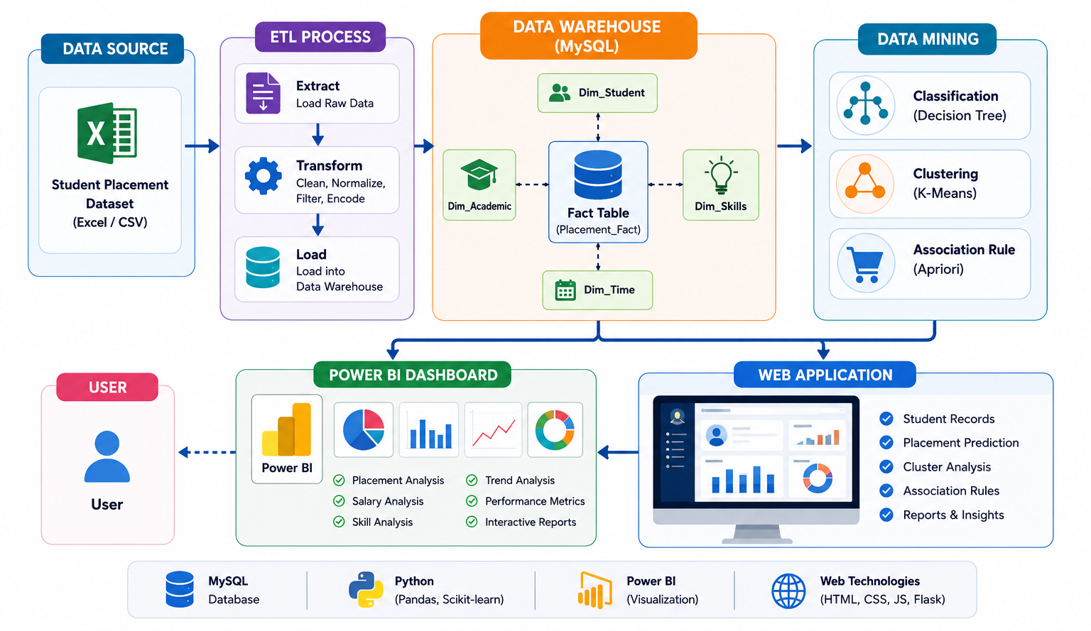
ARCHITECTURE DIAGRAM

Slide 7
LIST OF MODULES
Module 1: Data Collection & ETL
Module 2: Data Warehouse Design
Module 3: Data Mining & Placement Prediction
Module 4: Analytics & Power BI Dashboard
Module 5: Web Application & Reporting

Slide 8
Thank You !

